Slide 1
Introduction to SEM
DATA 695 Research Capstone Project
David Errington
Master of Data Science & Analytics Student
Faculty of Graduate Studies
July 7, 2025

Slide 2
Table of Contents
Territorial Acknowledgment
Chapter 1: Introduction, Background, & Review
What is Structural Equation Modelling?
Brief Review of Linear Regression
Linear Regression as a Structural Equation Model
Chapter 2: Path Analysis
Chapter 3: Confirmatory vs. Exploratory Factor Analysis
Chapter 4: Structural Equation Models w/ Latent Variables
References

Slide 3


Slide 4
Chapter 1: Introduction, Background, & Review

Slide 5

What is Structural Equation Modelling?
EVERYTHING THE LIGHT TOUCHES IS OUR SEM.

Slide 6
What is Structural Equation Modelling?
“…a linear model framework that models both simultaneous regression equations with latent variables.”
— Johnny Lin, PhD (2024)

Slide 7
What is Structural Equation Modelling?
SEM
Two or more endogenous variables
Observed variables
Latent variables
One endogenous variable
Observed variables
One exogenous variable
Multiple regression
Simple regression
Exogenous to endogenous
Multivariate regression
Path analysis
Endogenous to endogenous
Latent to observed
Latent to latent
Factor analysis
Two or more exogenous variables
Structural regression

Slide 8
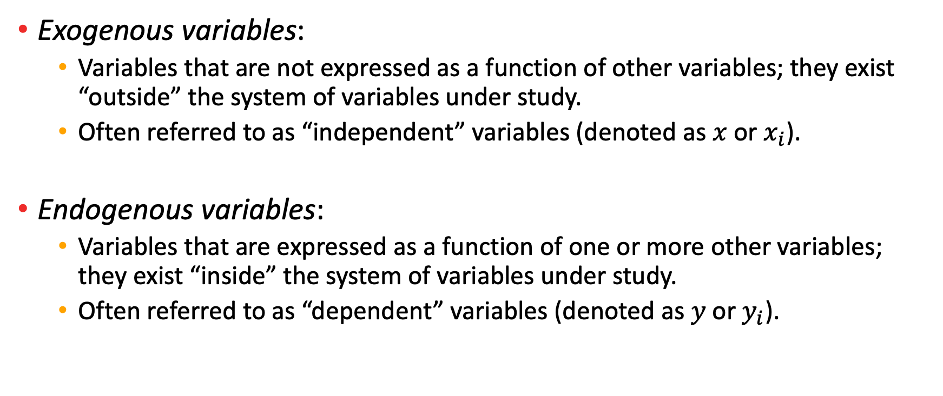
Terminology: Exogenous vs. Endogenous Variables
Exogenous variables:
Variables that are not expressed as a function of other variables; they exist “outside” the system of variables under study.
Often referred to as “independent” variables (denoted as $x$ or $x_{i}$).
Endogenous variables:
Variables that are expressed as a function of one or more other variables; they exist “inside” the system of variables under study.
Often referred to as “dependent” variables (denoted as $y$ or$y_{i}$).

Slide 9
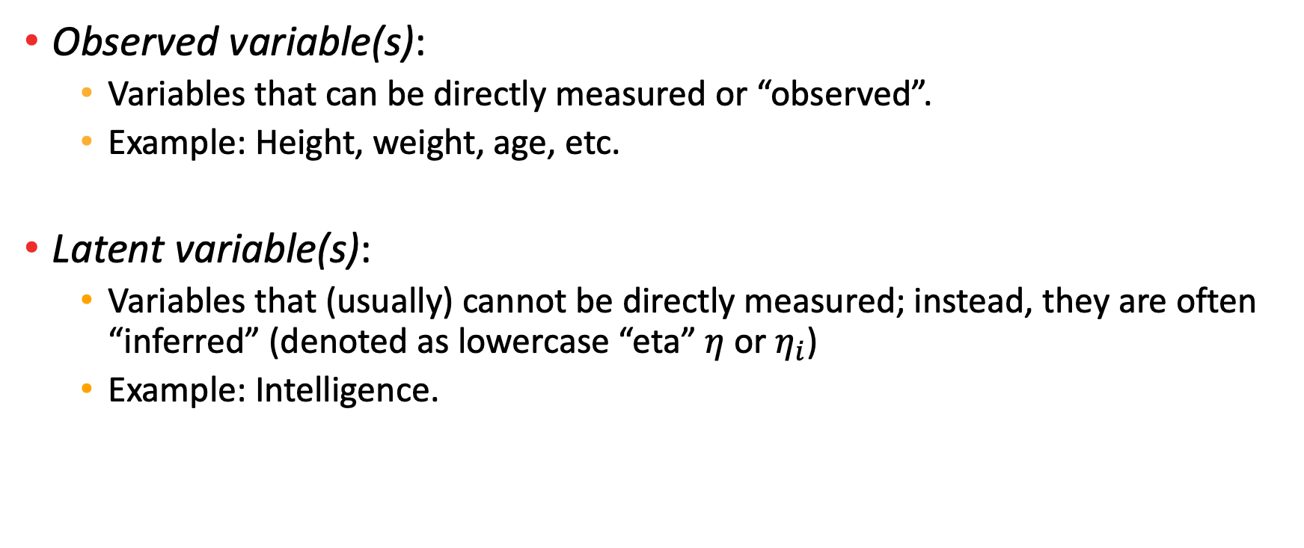
Terminology: Observed vs. Latent Variables
Observed variable(s):
Variables that can be directly measured or “observed”.
Example: Height, weight, age, etc.
Latent variable(s):
Variables that (usually) cannot be directly measured; instead, they are often “inferred” (denoted as lowercase “eta” $η$ or$η_{i}$)
Example: Intelligence.

Slide 10
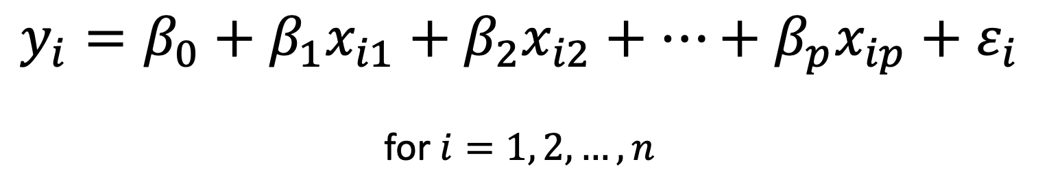

Brief Review of Linear Regression
Given a data set $\left\{y_{i}, x_{i1},…,x_{ip}\right\}$ of $n$ samples,
where $p=$ number of “independent” variables/predictors.
$$y_{i}=β_{0}+β_{1}x_{i1}+β_{2}x_{i2}+…+β_{p}x_{ip}+ε_{i}$$
for $i=1, 2, …, n$

Slide 11
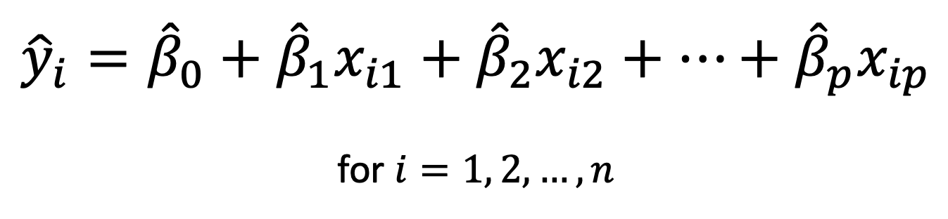
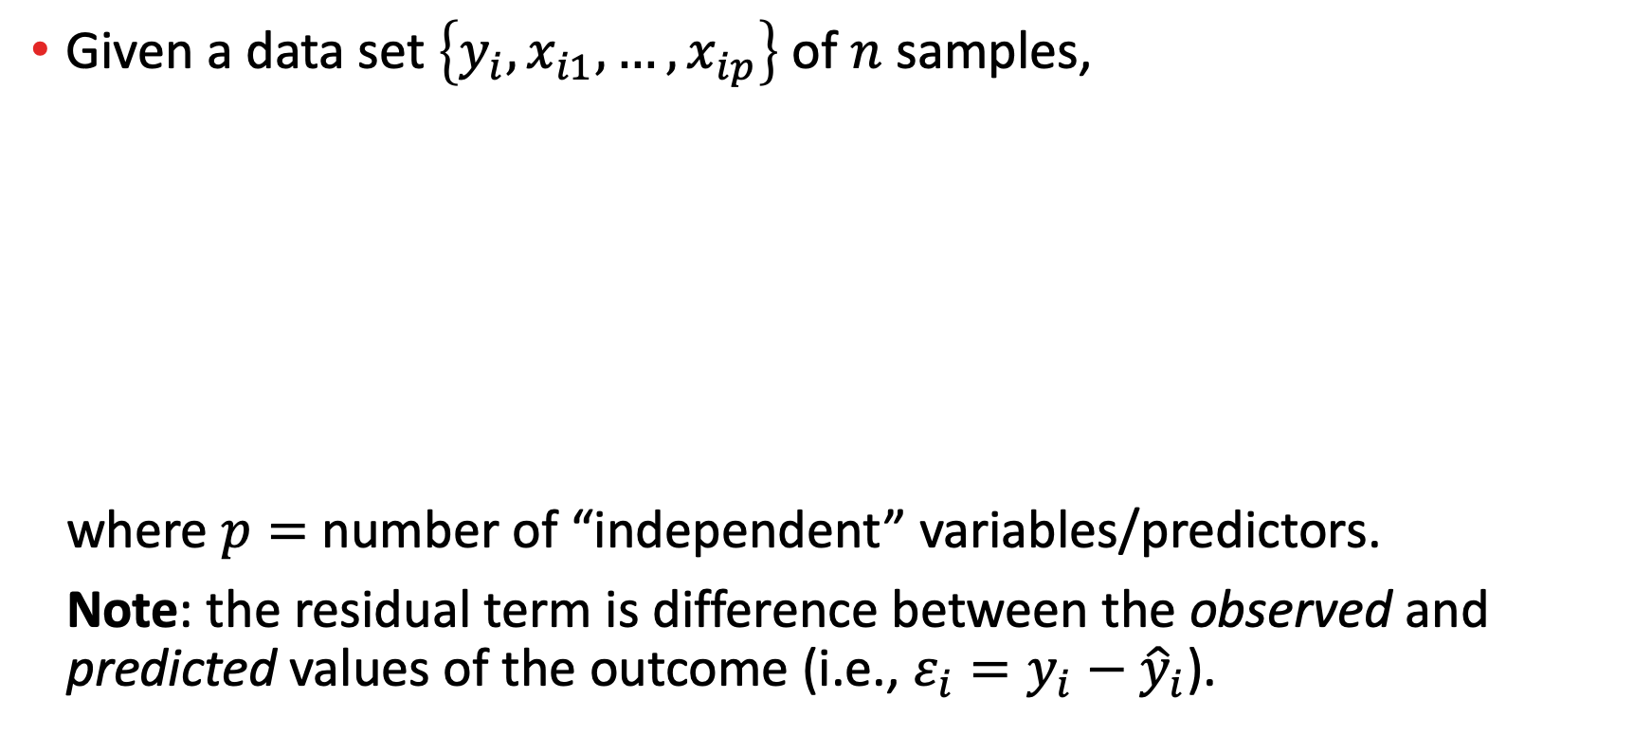
Brief Review of Linear Regression
Given a data set $\left\{y_{i}, x_{i1},…,x_{ip}\right\}$ of $n$ samples,
where $p=$ number of “independent” variables/predictors.
Note: the residual term is difference between the observed and predicted values of the outcome (i.e., $ε_{i}=y_{i}−{\hat{y}}_{i}$).
$${\hat{y}}_{i}={\hat{β}}_{0}+{\hat{β}}_{1}x_{i1}+{\hat{β}}_{2}x_{i2}+…+{\hat{β}}_{p}x_{ip}$$
for $i=1, 2,…, n$

Slide 12
Brief Review of Linear Regression
In R (or RStudio):
> model <- lm(y ~ x1 + ... + xp, data = ...)
Operator | Description
<- or = | Assign a value to a variable.
~ (tilde) | Define formula/relationship between two or more variables.

Slide 13
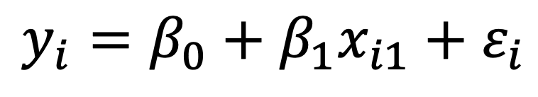
Linear Regression as a Structural Equation Model
Step 1: Start with linear regression equation.
$$y_{i}=β_{0}+β_{1}x_{i1}+ε_{i}$$

Slide 14

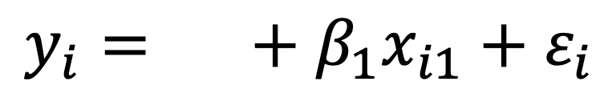
Linear Regression as a Structural Equation Model
Step 2: Take the intercept…
$$β_{0}$$
$$y_{i}=β_{0}+β_{1}x_{i1}+ε_{i}$$
Intercept

Slide 15

Linear Regression as a Structural Equation Model
Step 2: And replace it with “alpha”.
$$α$$
$$y_{i}=β_{0}+β_{1}x_{i1}+ε_{i}$$
Intercept

Slide 16
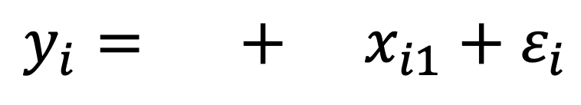
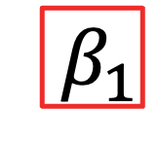
Linear Regression as a Structural Equation Model
Step 3: Take the regression coefficient(s)...
$$α$$
$${ β}_{1}$$
$$y_{i}=β_{0}+β_{1}x_{i1}+ε_{i}$$
Intercept
Coefficient

Slide 17
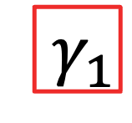
Linear Regression as a Structural Equation Model
Step 3: And replace it/them with “gamma”.
$$α$$
$${ γ}_{1}$$
$$y_{i}=β_{0}+β_{1}x_{i1}+ε_{i}$$
Intercept
Coefficient

Slide 18
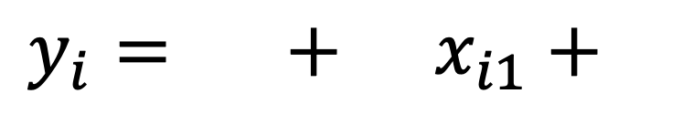

Linear Regression as a Structural Equation Model
Step 4: Take the residual error term...
Error
$$α$$
$${ γ}_{1}$$
$$ε_{i}$$
$$y_{i}=β_{0}+β_{1}x_{i1}+ε_{i}$$
Intercept
Coefficient

Slide 19
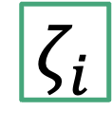
Linear Regression as a Structural Equation Model
Step 4: And replace it with “zeta”.
Error
$$α$$
$${ γ}_{1}$$
$$ζ_{i}$$
$$y_{i}=β_{0}+β_{1}x_{i1}+ε_{i}$$
Intercept
Coefficient

Slide 20

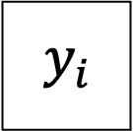

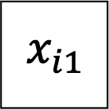




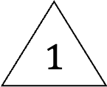

The Path Diagram
$$x_{i1}$$
$$γ_{1}$$
$$y_{i}$$
$$σ_{x}^{2}$$
$$1$$
$$ζ_{i}$$
$$ψ$$
$$μ_{x}$$
$$α$$
$$1$$

Slide 21
Path Diagram Legend
Observed variable
Latent variable
Constant
Path
Variance or covariance

Slide 22


(Simplified) Path Diagram
$$α$$
$$x_{i1}$$
$$γ_{1}$$
$$y_{i}$$
$$ψ$$

Slide 23
Chapter 2: Path Analysis

Slide 24

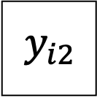

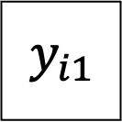
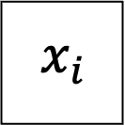



Example: Recursive Model (Mediation)
$$ζ_{i1}$$
$$ζ_{i2}$$
$$β_{12}$$
$$y_{i1}$$
$$y_{i2}$$
$$γ_{11}$$
$$γ_{12}$$
$$x_{i}$$

Slide 25
References
Bauer, D. J., & Curran, P. J. (2024). Introduction to Statistical Equation Modeling. CenterStat. https://centerstat.org/workshop/introduction-to-structural-equation-modeling/
Bollen, K. A. (1989). Structural Equations with Latent Variables. John Wiley & Sons, Incorporated. https://doi.org/10.1002/9781118619179
Lin, J. (2024). Introduction to Structural Equation Modeling (SEM) in R with lavaan. OARC Stats – Statistical Consulting Web Resources | UCLA. https://stats.oarc.ucla.edu/r/seminars/rsem/

